Slide 1
Predicting the Radius of Gyration of Small Molecules Using Machine Learning
By: Rana Elladki
December 2nd, 2025
Notes:
- Good morning everyone, my name is Rana and today I will be presenting my project on predicting the radius of gyration of small molecules using machine learning

Slide 2
Purpose/Goals
All objects possess a radius of gyration (RG2)
Calculating RG2 is computationally expensive
Machine learning (ML) predictions of RG2 using descriptors
RG2 predictions for material design
Notes:
The radius of gyration is a structural property used to describe the size of polymers of any architecture.
Although it is often associated with polymers, we can also use it to describe small molecules.
Molecular dynamics and density functional theory can be used to calculate the radius of gyration, but these methods are computationally expensive, especially for larger systems.
So, my project explores whether we can use molecular descriptors and machine learning models to predict RG2 quickly and accurately.
Ultimately, the goal is to support fast materials design or molecule screening based on predicted size.

Slide 3
Question
Which supervised machine learning model can provide the best radius of gyration predictions for small molecules, and which features have the largest impact on these predictions?
Notes:
Therefore, the main research question this project aims to answer is: which supervised machine learning model can provide the best radius of gyration predictions for small molecules, and which features have the largest impact on these predictions?

Slide 4
Outline of Machine Learning (ML) Workflow
Define problem
Collect data and EDA
Split data
Select model
Engineer features
Parameter tuning
Train model
Cross validation
Optimal model?
no
yes
Deploy model
Notes:
Starting with an outline of our machine learning workflow, I began by defining the problem as a machine learning problem, as shown on the previous slide.
Then, I collected a dataset of small molecules, followed by exploratory data analysis.
The data was then split, and features were engineered as necessary.
After that, selected and trained different models.
Each model is then validated, where it is decided whether to deploy the model if it is optimal or perform parameter tuning and retraining if necessary.
For the sake of time, I will skip the data extraction and EDA and jump into our models.

Slide 5
Models of Interest
Linear Regression (LR)
  Model 1: Filtered features
  Model 2: Filtered + logged features
Artificial Neural Network (ANN)
  Model 3: Filtered features
  Model 4: Filtered + logged features
  Model 5: Filtered + scaled features
Notes:
In this project, I evaluated 5 different models.
Two were linear regression models, one using filtered features, and another using filtered plus log-transformed features.
The other 3 were neural networks, using the same feature sets, with an additional variant that used feature scaling.

Slide 6
Computational Techniques
Linear Regression (LR)
  Scikit learn LinearRegression
Artificial Neural Network (ANN)
  Scikit learn MLPRegressor + GridSearchCV
    MLPRegressor:
      Activation: ‘ReLU’
      Optimizer: ‘ADAM’
    GridSearchCV to determine best:
      Hidden layer size
      Batch size
      Learning rate
Notes:
All models were built using the scikit learn library.
The Linear regression models were implemented using LinearRegression from scikit learn’s linear_model.
The ANNs were slightly more complicated and were implemented using MLPRegressor from scikit learn’s neural network with a ReLU activation function and the ADAM optimizer.
I also used GridSearchCV to perform hyperparameter tuning using 5-fold cross-validation to find the best configuration for the hidden layer count and size, batch size, and learning rate, yielding the optimal model architecture without requiring manual tuning.

Slide 7
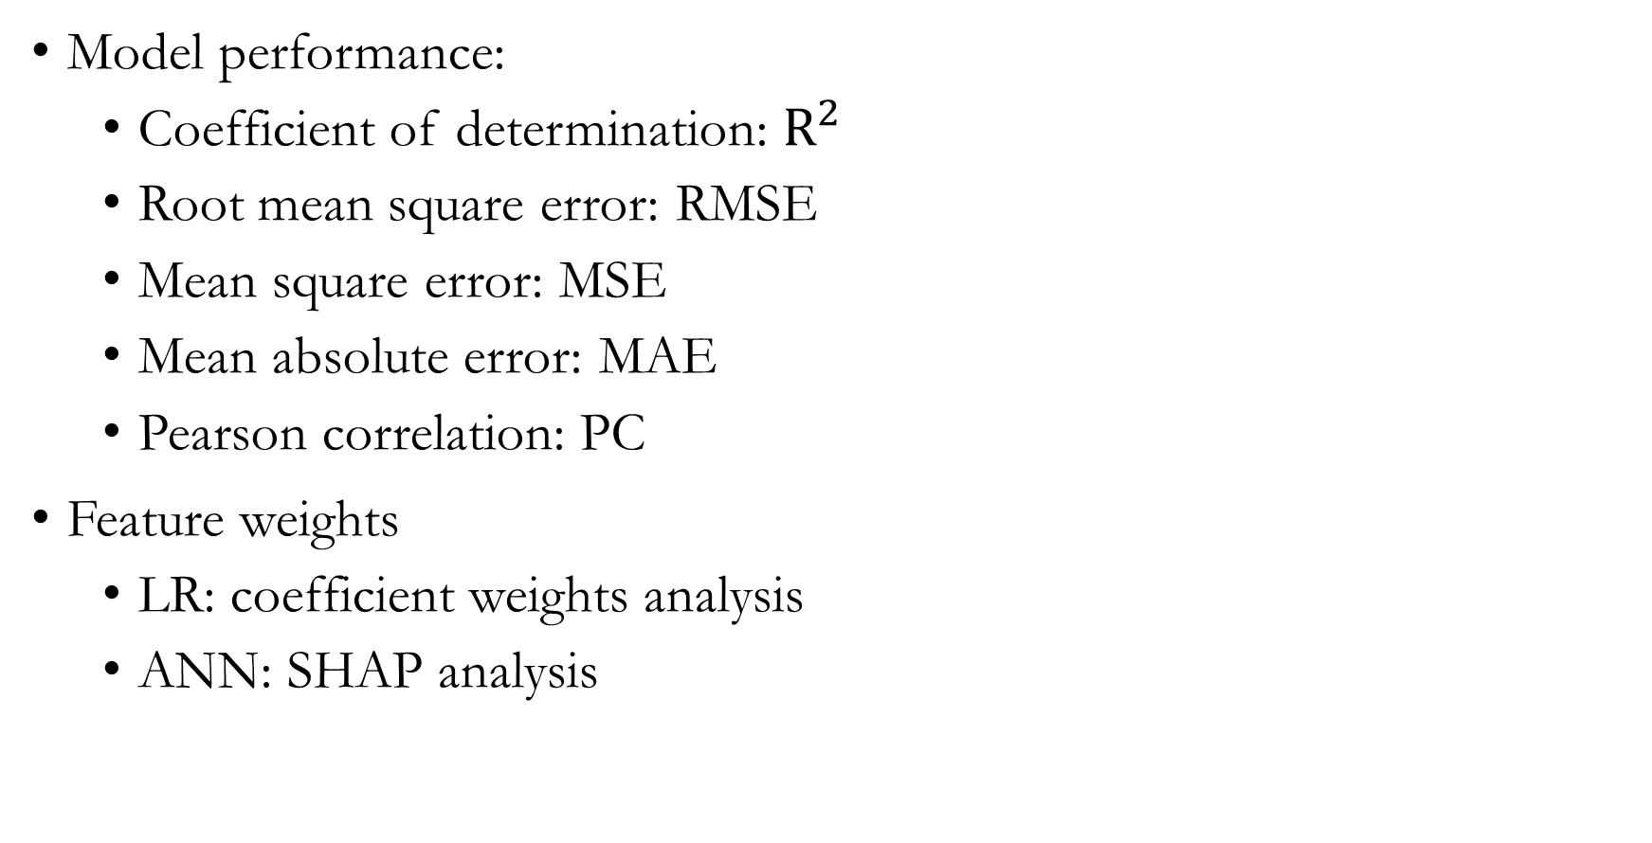
Statistical Analysis
Model performance:
  Coefficient of determination: $R^{2}$
  Root mean square error: RMSE
  Mean square error: MSE
  Mean absolute error: MAE
  Pearson correlation: PC
Feature weights
  LR: coefficient weights analysis
  ANN: SHAP analysis
Notes:
After training, all models were evaluated using standard statistical metrics.
R^2 measures how well the data fits the model
MSE measures the average of the squared differences between predicted and true values
RMSE is the square root of MSE and assigns a smaller penalty on deviations compared to MSE
MAE, measures the difference between predicted and true values and is less sensitive to outliers.
and lastly, the pearson correlation coefficient evaluates the correlation between the predicted and true values.
We also examined the coefficient magnitudes for the best LR model and conducted a shap analysis for the best ANN model, to compare feature influence on RG2 predictions.

Slide 8
Statistical Analysis
Model performance:
Model | Scaling | R² | RMSE | MSE | MAE | PC
--- VALIDATION SET ---
Linear Regression (LR) | -- | 0.819 | 0.434 | 0.189 | 0.312 | 0.905
Linear Regression (LR) | Log | 0.844 | 0.403 | 0.162 | 0.283 | 0.919
Artificial Neural Network (ANN) | -- | 0.789 | 0.469 | 0.22 | 0.329 | 0.906
Artificial Neural Network (ANN) | Log | 0.89 | 0.338 | 0.114 | 0.233 | 0.949
Artificial Neural Network (ANN) | Scaled | 0.927 | 0.275 | 0.076 | 0.186 | 0.963
--- TESTING SET ---
Linear Regression (LR) | -- | 0.819 | 0.432 | 0.186 | 0.314 | 0.905
Linear Regression (LR) | Log | 0.844 | 0.4 | 0.16 | 0.285 | 0.919
Artificial Neural Network (ANN) | -- | 0.789 | 0.466 | 0.217 | 0.33 | 0.904
Artificial Neural Network (ANN) | Log | 0.888 | 0.34 | 0.116 | 0.235 | 0.948
Artificial Neural Network (ANN) | Scaled | 0.926 | 0.277 | 0.077 | 0.189 | 0.963
Notes:
To make this table easier to read, metrics shown in green mean it is better to have a bigger values and metrics shown in red mean it is better to have a smaller value.
Based on the statistical metrics, the ANN models outperformed LR models across all metrics. (NEXT)
The model trained on standardized features achieved the best performance overall, with an R^2 of 0.93 on the testing set, the lowest error values across, and the highest Pearson correlation between the predicted and true values.

Slide 9
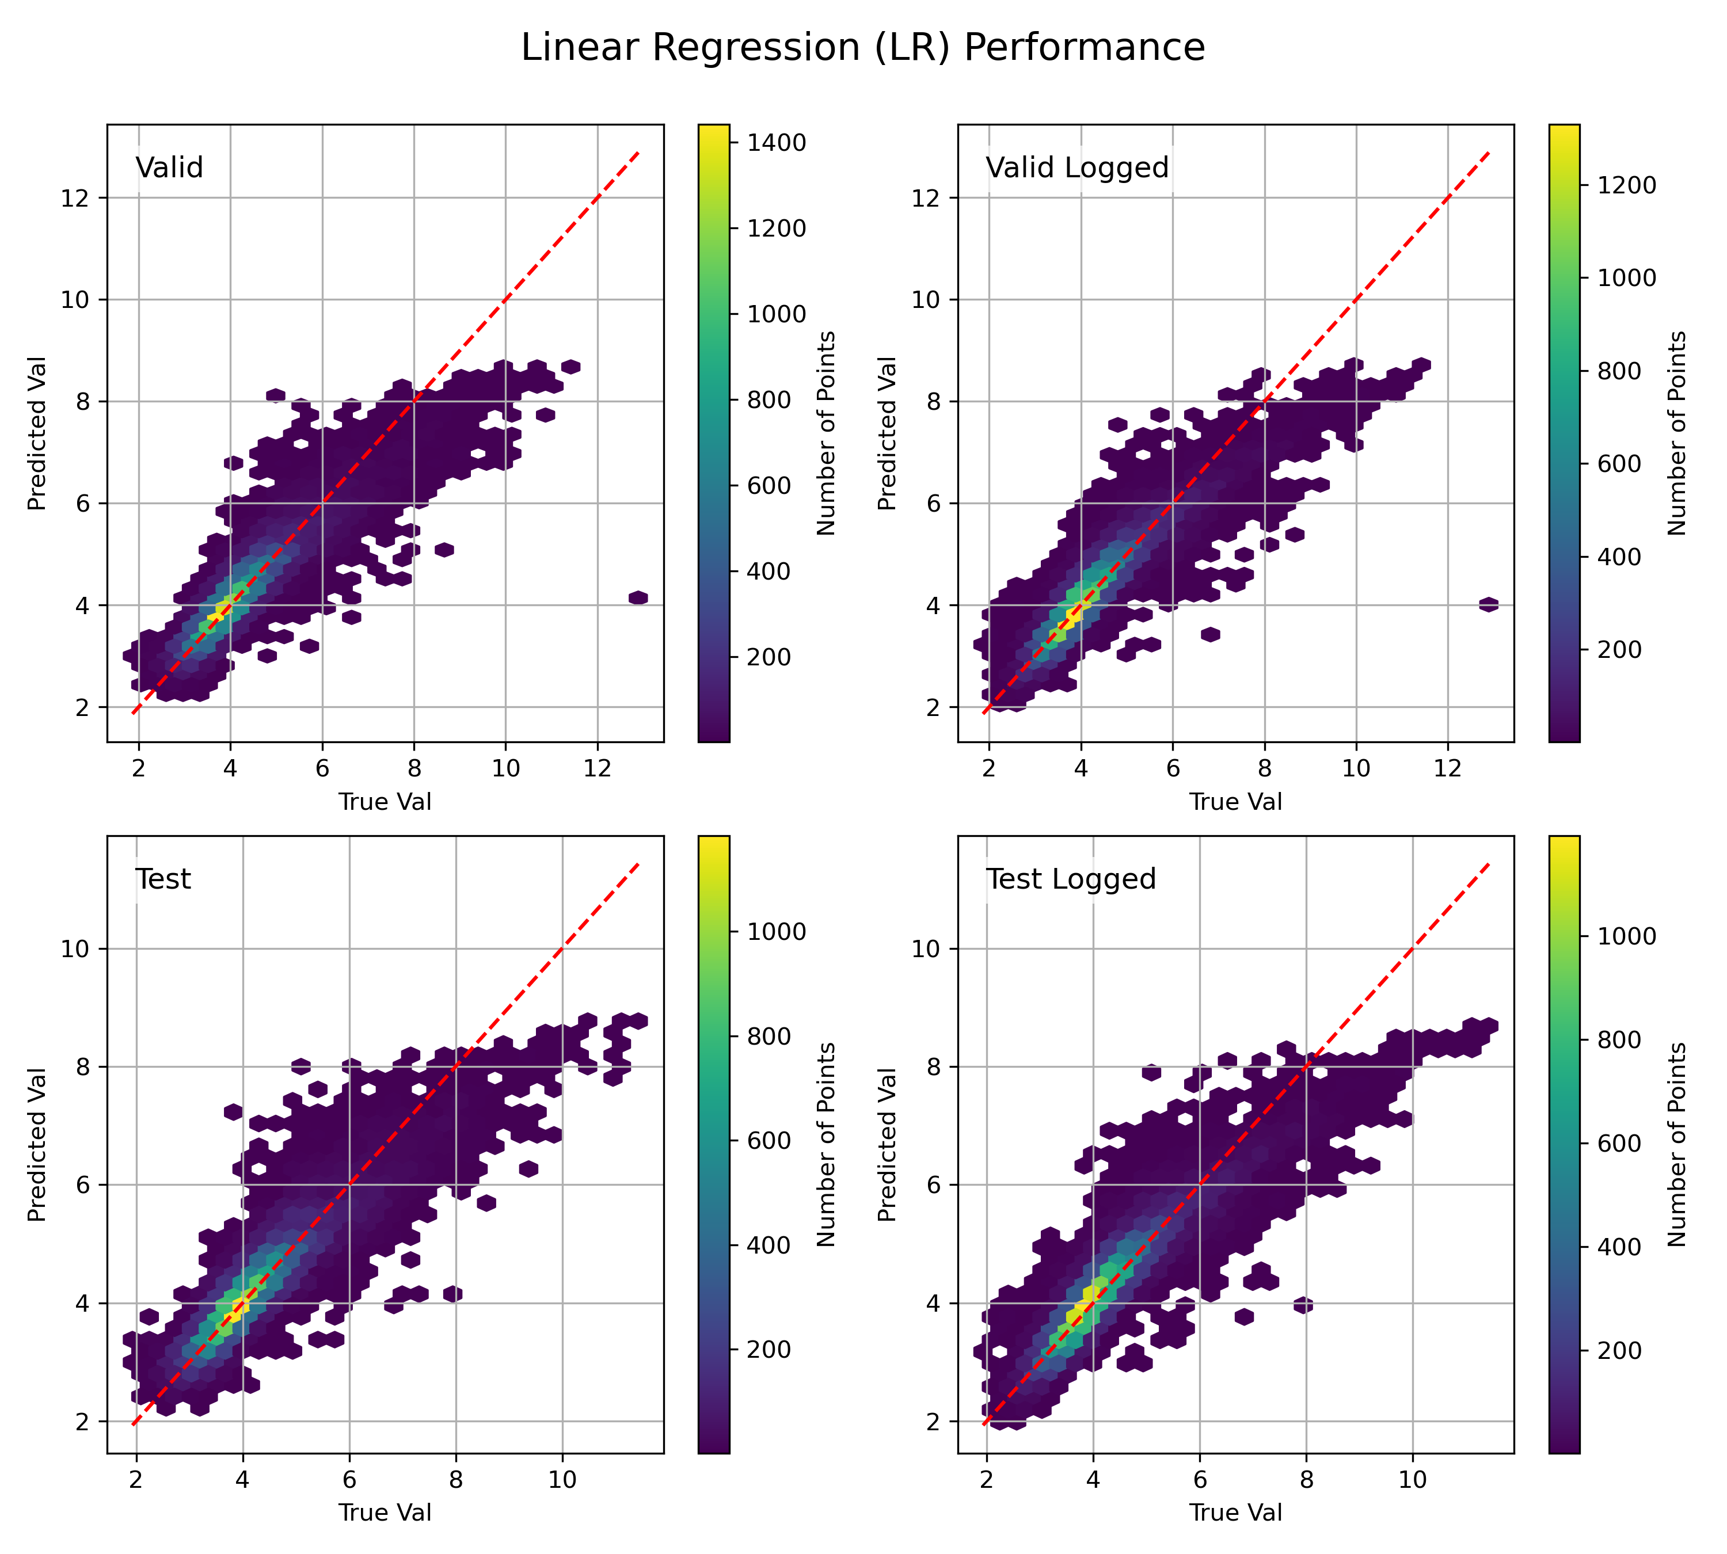
Results: Linear Regression
Notes:
Next, we can take a look at the predicted versus true plots for the two LR models.
The models performed reasonably well but showed signs of underfitting.
Both LR models struggled to predict large RG2 values (>8), likely due to the dataset containing relatively few molecules with high RG2 values or the model failing to capture complex non-linear relationships between molecular descriptors and RG2 accurately.
The log-transformed LR model performed better, but still showed underpredictions at the upper range.

Slide 10
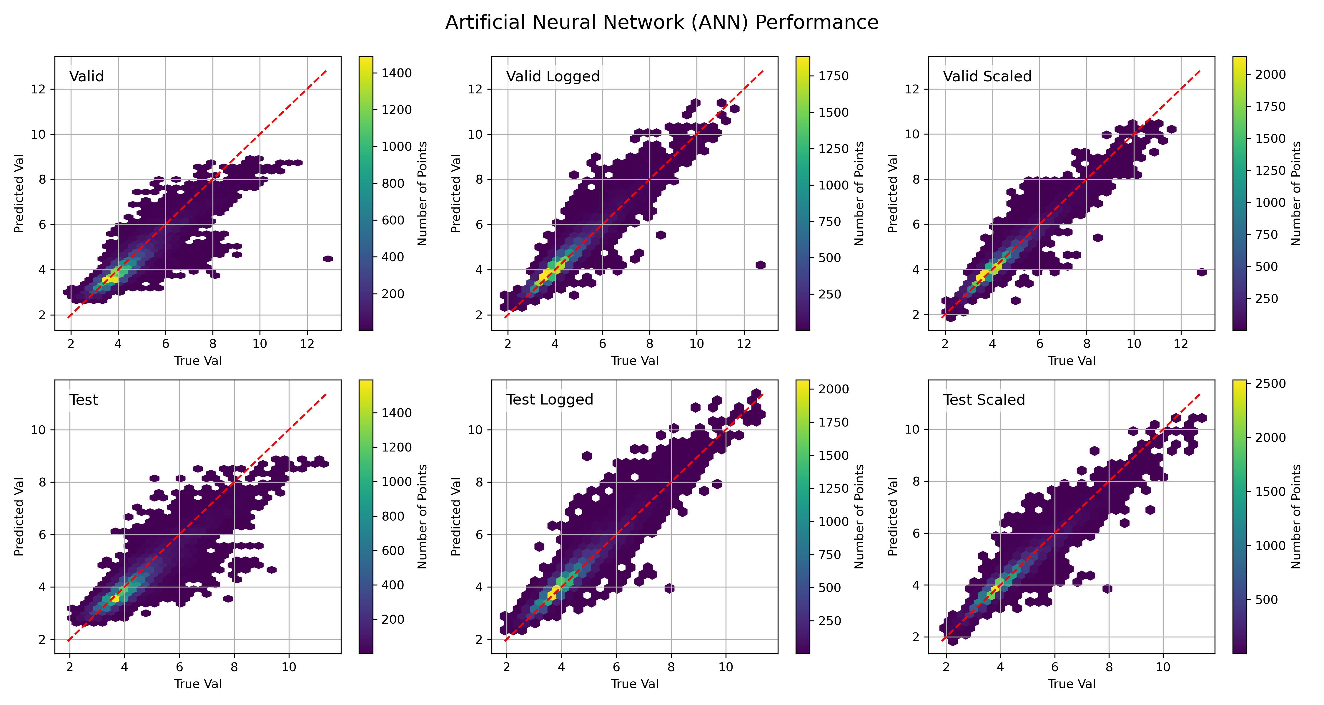
Results: Artificial Neural Network
Notes:
The ANN predictions show a similar trend with Model 3 underpredicting large RG2 values, but with significantly reduced deviation in models 4 and 5.
Model 3 exhibits the largest spread while models 4 and 5 align much more closely with the identity line.
When using filtered and log-transformed features, performance improves further, but the largest improvement comes from applying feature scaling.
Neural networks are sensitive to feature magnitude, so scaling can improve performance, by ensuring all featues contribute equally during training.

Slide 11
Results: Best Hyperparameters
ANN trained on scaled featuers
Two hidden layers
  Layer 1: 20 neurons
  Layer 2: 30 neurons
Batch size: 500
Learning rate: 0.01
Notes:
The best performing ANN was model 5, trained on scaled features.
Model 5’s optimal architecture yielded from GridSearchCV, used two hidden layers with 20 and 30 neurons, a batch size of 500, and a learning rate of 0.01.
This model provided the highest predicting accuracy and the lowest error compared to all models.

Slide 12
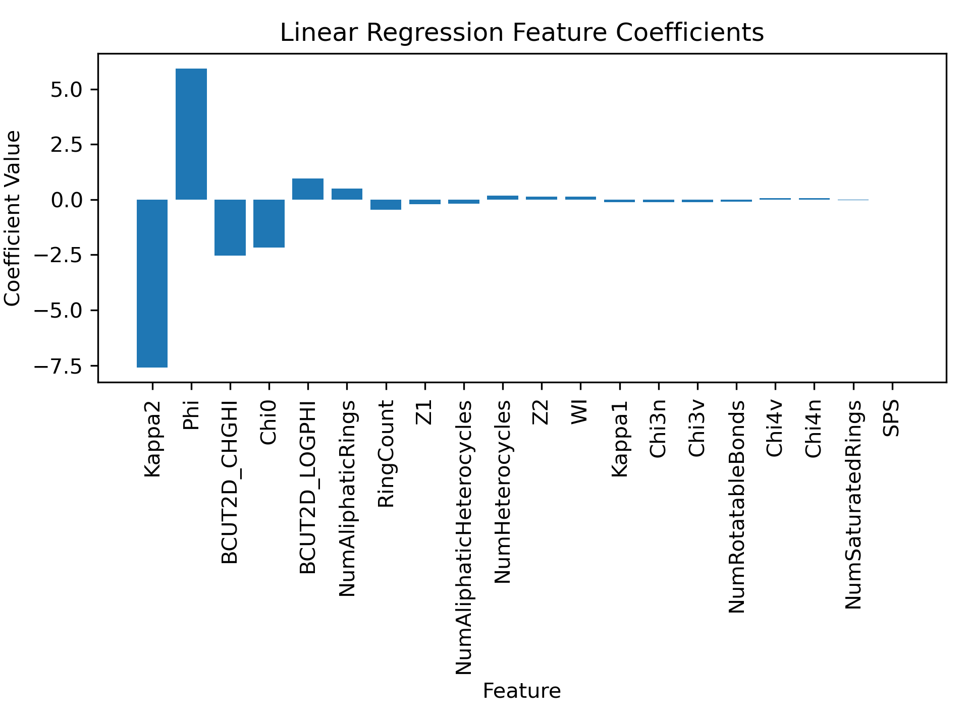
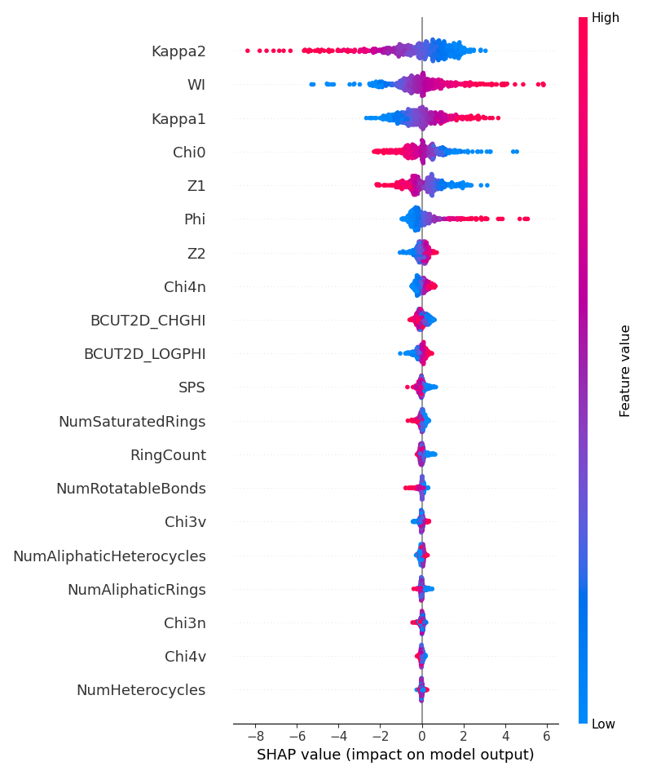
Impact of Descriptors on RG2
ANN SHAP Analysis
Notes:
Lastly, I analyzed which descriptors most strongly influence RG2 predictions by examining the coefficient magnitudes for the best LR model and conducting a SHAP analysis for the best ANN model.
Comparing the LR coefficient weights to the ANN SHAP scores, both models identified Kappa2 as the strongest feature negatively correlation with RG2, which is consistent with its interpretation as a measure of molecular branching compactness.
However, several features showed model-dependent importance.
For example, looking at the features within the dashed rectangles, both models identified them as having a strong impact on RG2 predictions, though Phi and Chi0 were not ranked as of the same importance.
More interestingly, the ANN assigned high importance to WI and kappa1, which is consistent with polymer physics. While the LR model showed little contribution from these features.
Therefore, this suggests that not only was the ANN able to capture nonlinear relationships between topological descriptors and RG2 that the LR could not, but it is also scientifically meaningful.

Slide 13
Future Work
Models trained on molecular graphs
  Convolutional neural networks (CNNs)
  Graph neural networks (GNNs)
Expanding the dataset to include conformers
Broader RG2 coverage
Notes:
In future work, several improvements could be implemented to strengthen model performance.
First, since the topological descriptors (which describe molecular structure) had the highest impact on RG2 predictions, I plan to train models directly on molecular graphs rather than using precomputed descriptors.
Graph neural networks and convolutional neural networks can capture molecular structure more naturally.
Since the RG2 is geometry dependent, incorporating conformer information would also be beneficial.
A few of the models also struggled to predict larger RG2 values, so a dataset containing larger molecules with higher RG2 values can impact model predictions.
The database used in this project did not contain any conformers and was limited to small molecules, so in the future, I hope to expand the dataset beyond the QM9 database to include more conformers and a broader range of RG2 values.

Slide 14
Questions
Notes:
Thank you for listening, and I’d be happy to take any questions.

